Slide 1
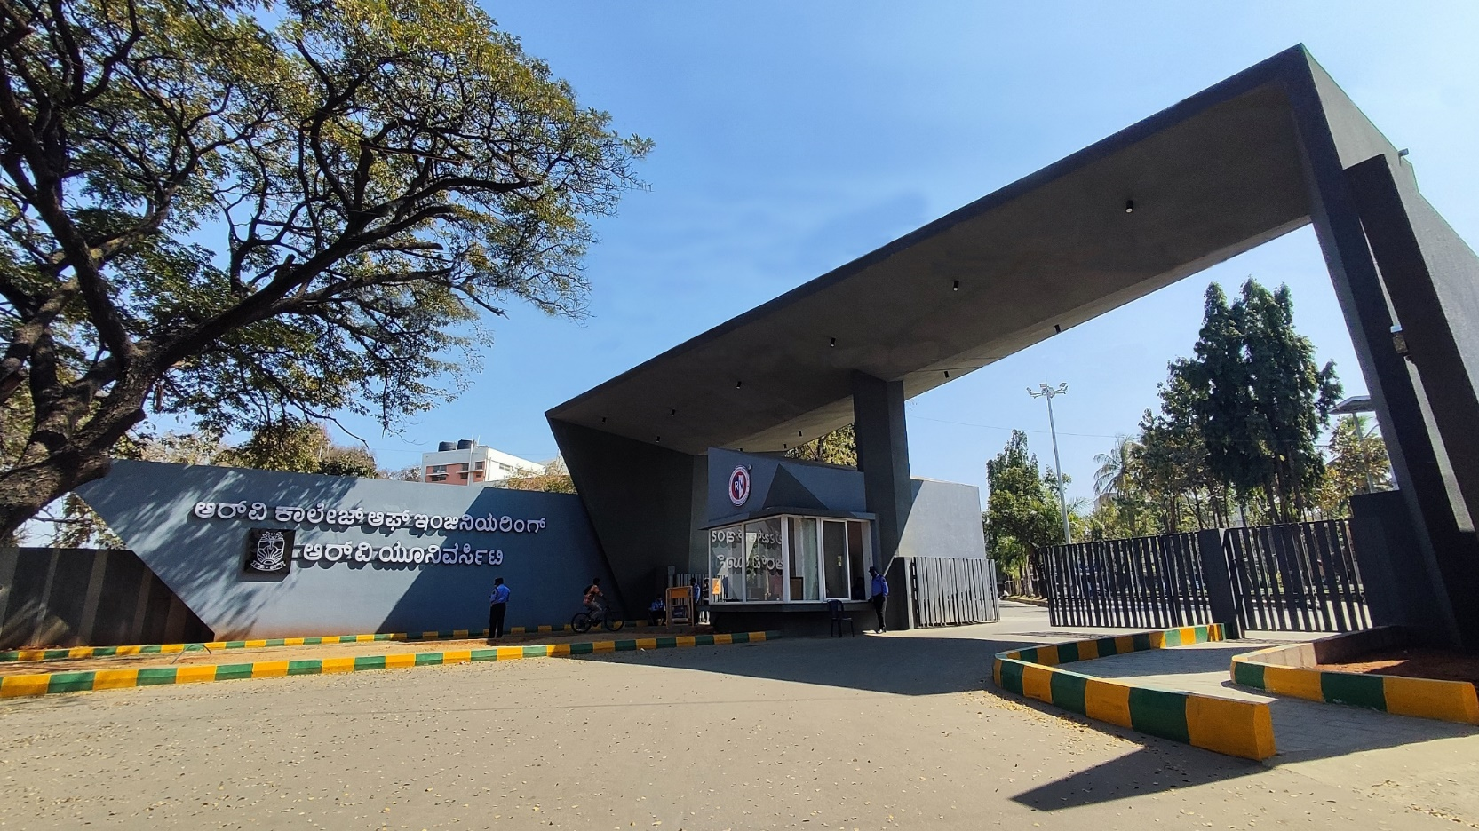
Design and Development of an RFID and Bluetooth -Based Smart Lock System Using Arduino UNO
IDEA LAB PHASE-1 & 2

Slide 2




Team Members
Name: Aamani Jha
USN: 1RV24IS002
Name: Aayushi Priya
USN: 1RV24IS005
Keshavamurthy YC
Idea Lab ISE B1
Dept of Mechanical Engg
RVCE
Name: Eshita Sahu
USN: 1RV24IS036

Slide 3
IDEA LAB Phase-1 & 2
Presentation Outline
Introduction
Literature Review
Problem Definition
System Design and Architecture
Hardware and Software Implementation
Experimental Setup
Results & Discussion
Conclusion & Future Work
References
Appendices – Arduino code snippets

Slide 4
Introduction:
Security in residential and commercial spaces often suffers due to the limitations of traditional locks, such as key loss, duplication, and tampering. This project proposes an RFID and Bluetooth-based smart locking system using Arduino UNO and a servo motor to provide secure and convenient access through tag authentication and a Bluetooth device in case tag is not available. Designed as a low-cost, customizable solution for non-critical applications like personal lockers or classroom cabinets, the system uses easily available components and works offline for simplicity and reliability. It also lays the groundwork for future upgrades such as GSM alerts, biometric authentication, or IoT integration.

Slide 5
Literature Review:
RFID-based security systems have gained significant popularity due to their contactless operation, ease of integration, and cost-effectiveness. Typically comprising an RFID reader, programmable tags, and a controller such as Arduino or Raspberry Pi, these systems authenticate users by reading a tag’s unique ID and verifying it against stored data. For instance, T.S. Rappaport (2022) offered foundational insights into RFID technologies, A. Sharma (2023) demonstrated beginner-level Arduino applications, and M. Patel (2023) expanded upon these by integrating RFID with IoT for smart home systems. Despite this, current solutions show several gaps, including high cost and complexity in advanced models, limited flexibility for educational or small-scale use, lack of entry-level systems with realistic lock mechanisms, and minimal modularity for future upgrades like IoT or biometric integration. This review underscores the need for a cost-effective, customizable, and modular RFID-based locking prototype, aimed at educational and practical applications. The proposed project seeks to fill this gap by offering a simple yet scalable system that supports hands-on learning and potential real-world deployment.

Slide 6
Problem Definition:
Traditional RFID-based door locking systems face limitations such as reliance on physical RFID tags for access, which can lead to inconvenience and safety concerns if tags are lost or forgotten. In shared access environments like hostels or apartments, this can disrupt normal operations and compromise security.

Slide 7
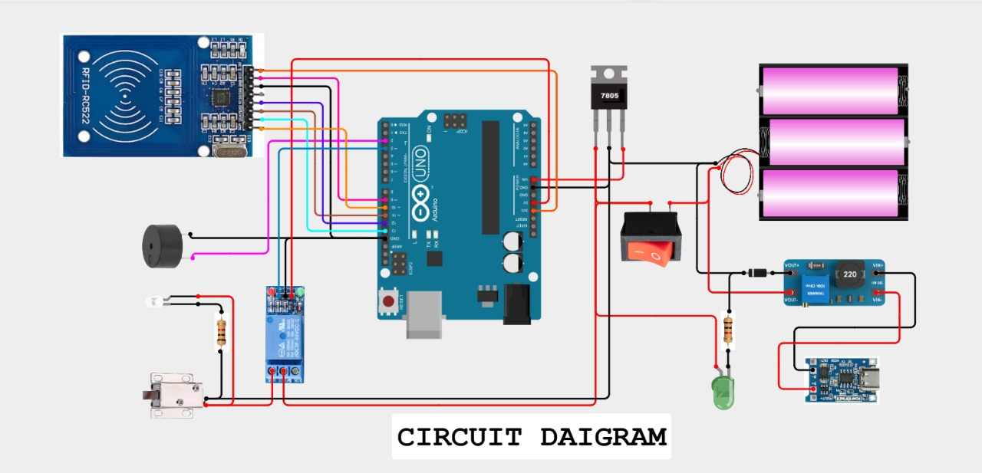
System Design and Architecture:
This circuit diagram illustrates an RFID-based smart locking system using Arduino UNO. The RFID reader (RC522) scans tags and sends data to the Arduino, which then activates a relay to control a solenoid lock if the tag is authorized. A buzzer and LED provide feedback for access status. The system is powered by a rechargeable battery pack regulated through a 7805 voltage regulator and managed by a TP4056 charging module. An optional AC-DC converter allows mains power use, making the setup reliable, low-cost, and ideal for secure access in lockers or cabinets.

Slide 8
Hardware and Software Implementation:
i)Arduino UNO: The brain of the system. It runs the code written, handles communication with the RFID reader, checks the card UID, and controls the buzzer, LEDs, relay, and solenoid lock based on access rules.
ii)RFID Reader Module: Reads data from RFID tags/cards. Communicates the card’s unique ID (UID) to the Arduino via SPI protocol.
iii) RFID Tag: The ‘key’ for the system. Each tag has a unique ID. If the ID matches the allowed ID in the code, access is granted.
iv) Buzzer: Gives audible feedback. Beeps when access is denied. Controlled by Arduino pin 2 in the code.
v) 5V Relay Module: Works like a switch to control high-power devices (solenoid lock) using the low-power Arduino output. Relay pin controlled by pin 3 in the code. When activated, it closes the circuit to power the solenoid lock.
vi) Solenoidal Lock: The actual door lock. Normally locked. When relay activates, it unlocks, letting the door open.
vii) 7805 Regulator: Voltage regulator. Converts higher battery voltage to stable 5V for Arduino & peripherals.
viii) Switch: Manual ON/OFF for the whole circuit. Acts as a master power switch.
ix) 18650 Rechargeable Batteries (x3): Power supply. 3 cells provide enough voltage & current for the whole system, including the solenoid lock.
x) MT3608 Booster: Boosts voltage when needed to maintain stable operation (optional here, but can help maintain voltage under load).
xi) TP4056 Charging Module: Used to charge the 18650 batteries safely via USB.
xii) HC-05 Bluetooth module: It is connected to the Arduino to receive commands from a mobile device.

Slide 9
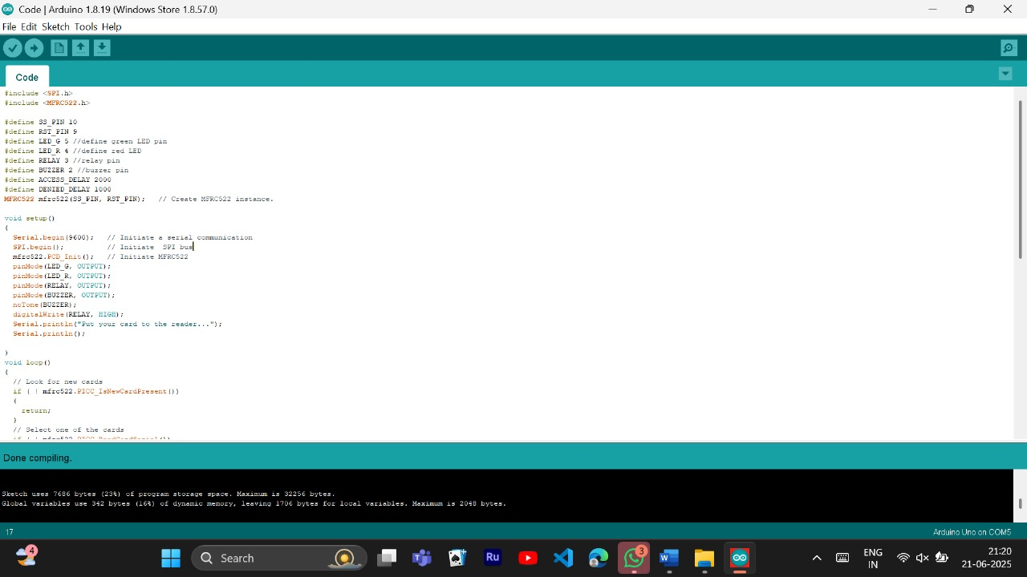
Hardware and Software Implementation:
This Arduino code initializes an RFID-based smart lock system. It includes necessary libraries for SPI communication and the MFRC522 RFID reader. Pin assignments are defined for the RFID module, LEDs, relay, and buzzer. In the setup() function, serial communication, SPI, and RFID modules are initialized, and the I/O pins are set up. The system waits for RFID card input and displays a message prompting the user to scan a tag. The loop() function (partially shown) begins checking for new RFID cards, preparing the system to validate scanned tags for access control.

Slide 10
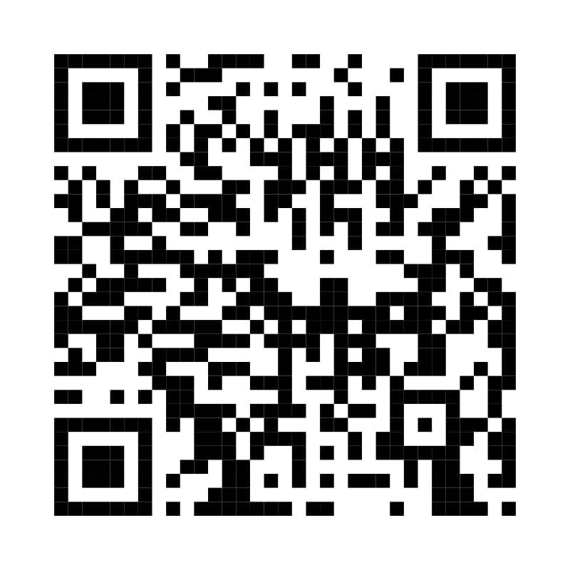
Experimental Setup:
The setup consists of an Arduino UNO connected to an RFID reader (RC522), which scans RFID tags to verify access. A solenoid lock is controlled through a relay module, which gets triggered when an authorized tag is detected. A green LED lights up and a buzzer beeps briefly on successful access; a red LED and a longer buzzer sound indicate unauthorized access.
Power is supplied through a battery pack, stepped down to 5V using a 7805 voltage regulator, ensuring safe operation of components. The battery is rechargeable using a TP4056 module, and an AC to DC converter allows optional charging from the mains. A push switch is used to turn the system on/off.
All components are assembled on a breadboard or baseboard for stability, and the system operates offline—ideal for lockers or cabinets in classrooms or homes. The experiment verifies the system’s functionality by scanning RFID tags and observing the lock and feedback components' responses.

Slide 11
Results and Discussions:
The developed smart lock system functioned reliably using both RFID authentication and Bluetooth-based control. The system accurately recognized authorized RFID tags and rejected unauthorized ones with appropriate LED and buzzer feedback. Similarly, the Bluetooth module (HC-05) responded correctly to valid commands from the mobile app while ignoring invalid inputs, ensuring secure operation.
The servo motor performed consistently in response to both authentication methods, demonstrating strong hardware-software integration. Testing showed the Bluetooth range to be effective up to approximately 10 meters, providing added convenience when RFID tags were not available.
Additionally, the TP4056 charging module and MT3608 voltage booster enabled stable battery-powered operation, making the system portable and functional during power outages. The manual switch offered a reliable emergency access option.
Overall, the project met its objectives of providing a dual-authentication, secure, and user-friendly smart locking solution suitable for shared spaces such as hostels or lockers. Minor limitations, such as the short RFID range and lack of real-time monitoring, present opportunities for future enhancements like IoT integration or biometric access.
.

Slide 12
Conclusion and Future work:
The project successfully demonstrated a low-cost, portable, and reliable RFID and Bluetooth-based smart locking system using Arduino UNO. The system provided secure access through dual authentication modes, ensured stable performance on battery power, and offered user-friendly operation through a mobile app and manual override.
The integration of readily available components and simple embedded programming makes this solution ideal for personal lockers, hostel doors, and classroom cabinets. It addresses key limitations of traditional locks, such as the loss of physical keys or tags, by offering flexible alternatives.
Future Work includes:
Adding IoT functionality for remote access and monitoring
Incorporating biometric authentication for enhanced security
Implementing access logging via EEPROM or cloud storage
Developing a dedicated mobile app UI for better user experience
Designing a compact and durable enclosure for real-world deployment
This project lays the foundation for scalable smart security systems adaptable to various environments.

Slide 13
References:
T. S. Rappaport, RFID and Contactless Technology Basics, Wiley, 2022.
A. Sharma, “Arduino Projects for Beginners,” International Journal of Embedded Systems, vol. 12, pp. 45–52, 2023.
M. Patel, “Smart Security Systems using RFID and IoT,” Journal of Emerging Technology, vol. 18, no. 3, pp. 98–104, 2023.
Arduino, “Arduino Documentation,” [Online]. Available: https://docs.arduino.cc. [Accessed: 19-Jun-2025].
Components101, “RC522 RFID Module Datasheet,” [Online]. Available: https://components101.com/rfid-rc522-module.
D. Kumar and R. Singh, “Design and Implementation of IoT-Based Smart Door Lock System,” International Journal of Computer Applications, vol. 182, no. 25, pp. 18–22, 2021.
N. Gupta and S. Verma, “RFID Based Secure Lock System Using Arduino and GSM,” International Journal of Advanced Research in Electronics and Communication Engineering (IJARECE), vol. 9, no. 5, pp. 111–114, May 2022.
B. A. Forouzan, Data Communications and Networking, 5th ed., McGraw-Hill, 2013.
H. ElSayed et al., “A Review on Smart Lock System Technologies,” International Journal of Smart Home, vol. 14, no. 2, pp. 1–10, Apr. 2020.
J. L. Hellerstein, “Embedded Systems Design: A Unified Hardware/Software Introduction,” IEEE Micro, vol. 23, no. 4, pp. 15–27, Jul.–Aug. 2003.

Slide 14
Appendices:
Component List:
Arduino UNO
RC522 RFID Reader
HC-05 Bluetooth Module
SG90 Servo Motor
TP4056 Charging Module
MT3608 Voltage Booster
18650 Li-ion Batteries (x3)
LEDs, Buzzer, Relay, Push Button, Resistors, Jumper Wires, Breadboard
Mobile App Tool Used:
Bluetooth Terminal App (for testing commands like “OPEN”)
Testing Log Samples:
Valid tag unlocks the door (LED ON, Servo 90°)
Invalid tag triggers buzzer alert
Bluetooth command “OPEN” activates lock
Battery operation confirmed for 2+ hours

Slide 15


